Slide 1
Overview
Computer Arithmetic's
Addition and Subtraction
Multiplication Algorithms
Division Algorithms
Decimal Arithmetic Unit
BCD Operation
Decimal Arithmetic operations

Slide 2
Computer Arithmetic’s
Arithmetic Instruction Manipulate data to produce results necessary for the solution of computational problem
Four Basic Arithmetic Operations are – Addition, Subtraction, Multiplication and Division
An arithmetic processor is the part of a processor unit that executes arithmetic operations
Arithmetic operations can be performed for following data types
Fixed point binary data in signed magnitude representation
Fixed point binary data in signed 2’s complement representation
Floating Point binary data
Binary coded decimal data

Slide 3
Addition and Subtraction
Representation of both positive and negative numbers
- Following 3 representations
Signed magnitude representation
Signed 1's complement representation
Signed 2's complement representation
Example: Represent +9 and -9 in 7 bit-binary number
Only one way to represent + 9 ==> 0 001001
Three different ways to represent - 9:
In signed-magnitude: 1 001001
In signed-1's complement: 1 110110
In signed-2's complement: 1 110111
Fixed point numbers are represented either integer part only or fractional part only.

Slide 4
Addition and Subtraction
Addition and Subtraction with Signed Magnitude Data
Operation | Add Magnitudes | Subtract Magnitudes
 |  | A>B | A<B | A=B
( + A ) + ( + B ) | + ( A + B )
( + A ) + ( - B ) |  | + ( A - B ) | - ( B - A ) | + ( A - B )
( - A ) + ( + B ) |  | - ( A - B ) | + ( B - A ) | + ( A - B )
( - A ) + ( - B ) | - ( A + B )
( + A ) - ( + B ) |  | + ( A - B ) | - ( B - A ) | + ( A - B )
( + A ) - ( - B ) | + ( A + B )
( - A ) - ( + B ) | - ( A + B )
( - A ) - ( - B ) |  | - ( A - B ) | + ( B - A ) | + ( A - B )

Slide 5
Computer Arithmetic’s
Addition (subtraction) Algorithm
When the sign of A and B are identical (different) , add the magnitudes and attach the sign of A to the result.
When the signs of A and B are different (identical), compare the magnitudes and subtract the smaller number from the larger.
Choose the sign of result to be same as A if A>B
or the complement of sign of A if A<B
if A=B subtract B from A and make the sign of result positive

Slide 6
Hardware Implementation
B_{s}
B Register
AVF
Complementer
M (ModeControl)
E
Parallel Adder
Output Carry
Input Carry
A_{s}
A Register
Load Sum
Simple procedure require magnitude comparator, an adder, two subtractor however alternative
reveals that using 2’s complement for operation requires only an adder and a complementor
M=0 output = A+B M=1 output = A+B’+1= A-B

Slide 7
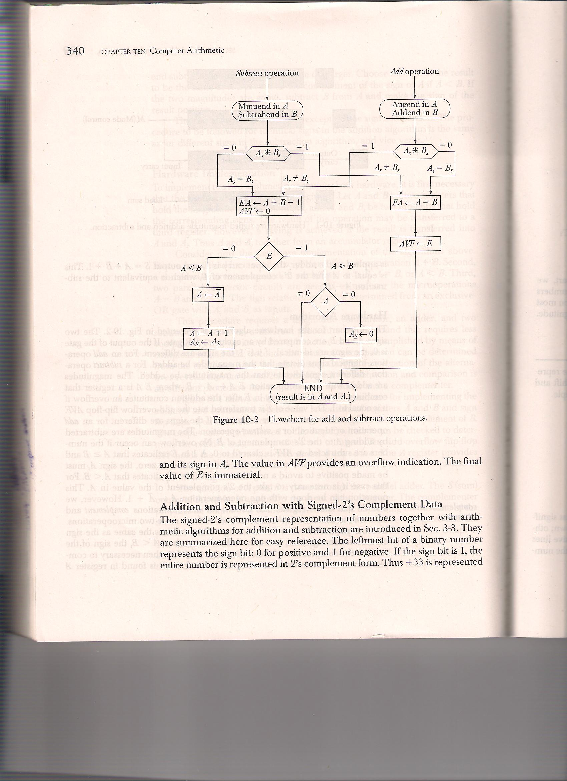
Flow Chart for Add and Subtract Operation

Slide 8
Signed 2’s Complement Representation
Addition :
Addition of two numbers in signed 2’s complement form consists of adding the numbers with the sign bits treated the same as the other bits of the number. Carry out of sign bit is discarded
Sum is obtained by adding the content of AC and BR (including the sign bit). Overflow bit is set to 1 if EX-OR of last two carries if 1
Subtraction :
Here Subtraction consists of first taking the 2’s complement of the subtrahend and then adding it to minuend
Subtraction done by adding the content of AC to 2’s Complement of BR.

Slide 9
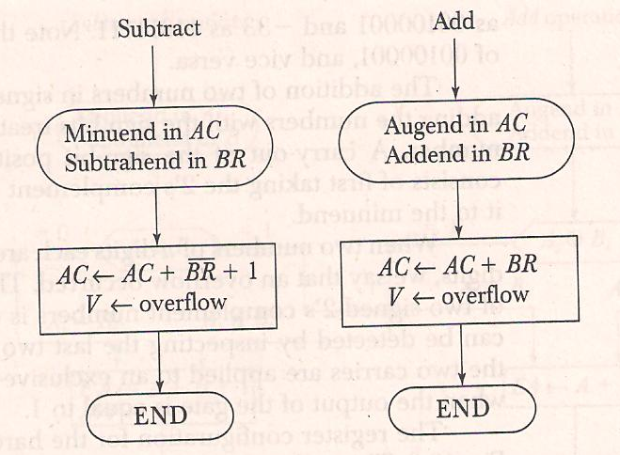
Signed 2’s Complement Representation

Slide 10
Any Questions ?

